Slide 1
A Very brief history of the english language
Old English
Middle English
Early-Modern English

Slide 2
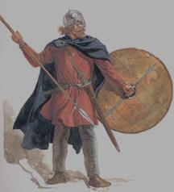
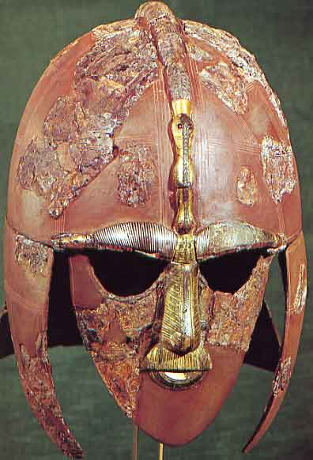
Old English Ca. 650-1066
Not the English spoken by Shakespeare!
Old English was spoken by the Anglo Saxons – a group of people living in Britain before the Norman (French) Invasion of 1066.
The Anglo Saxons were a Germanic People, descended from three primary invading tribes: the Angles, the Saxons, and the Jutes.
Image Source: www.stedmundsbury.gov.uk/sebc/visit/410ad-865ad.cfm; http://www.essentialnormanconquest.com/

Slide 3
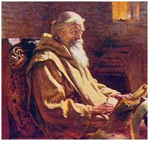
Old English
Cædmon’s Hymn
Nu we sculon herigean heofonrices weard,
meotodes meahte ond his modgeþanc,
weorc wuldorfæder, swa he wundra gehwæs,
ece drihten, or onstealde.
He ærest sceop eorðan bearnum
heofon to hrofe, halig scyppend;
þa middangeard moncynnes weard,
ece drihten, æfter teode
firum foldan, frea ælmihtig.
Image Source: http://en.wikipedia.org/Cædmon; http://en.wikipedia.org/wiki/Bede.

Slide 4
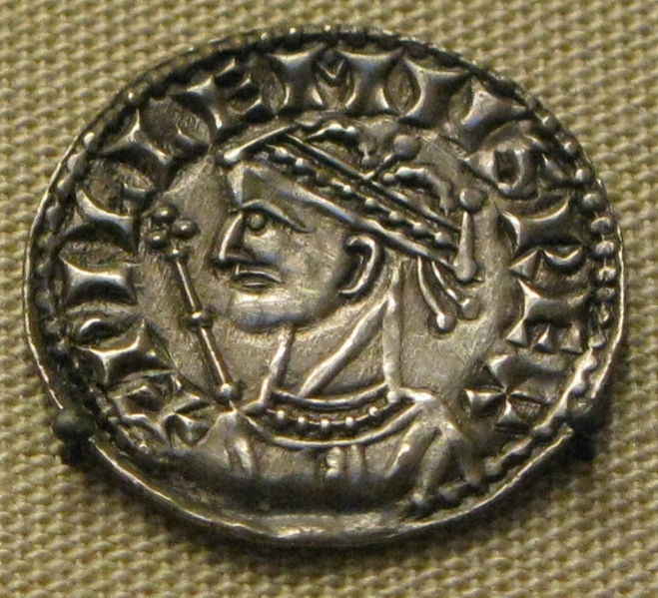
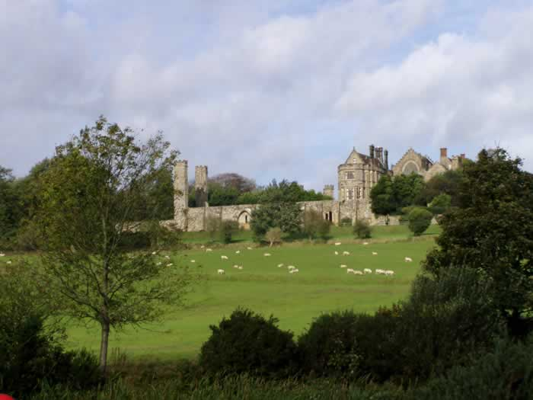
Middle English Ca. 1066 - 1500
What happened in Britain in the year 1066?
William the Conqueror invades England with his Norman (French) Army and defeats the army of Harold Godwinson at the Battle of Hastings.
The infusion of the Norman language (Old French) which was Latin based, with the Anglo-Saxon language (Old English) which was Germanic, led to a hybridization which would become Middle English.
Image Source: http://www.castleuk.net/castle_lists_south/199/images/1066.jpg

Slide 5
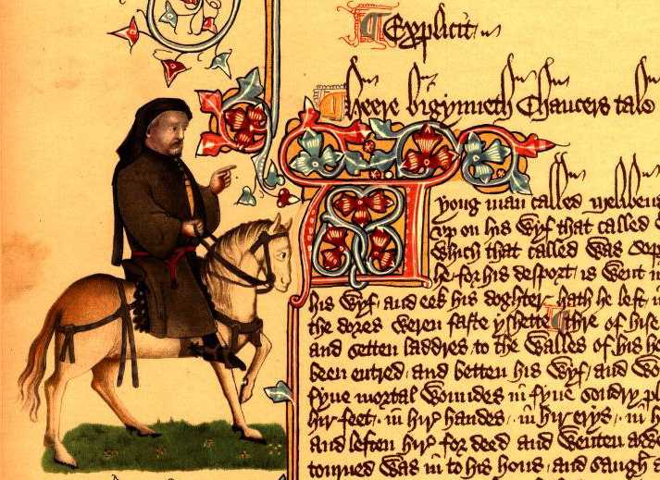
Middle English
Piers Plowman (Prologue)
In a somer seson whan soft was the sonne
I shope me in shroudes as I a shepe were;
Went wyde in this world, wondres to here.
Ac on a May mornyng, on Malverne Hulles,
Me byfel a ferly, of fairy me thoughte:
I was wery forwandred and went to reste
Under a brode banke bi a bornes side,
And as I lay and lened and loked in wateres
I slombred in a slepyng…
Image source: http://www.piersplowman.org/; http://oneeyedman.net/school-archive/classes/fulltext/chaucer.jpg

Slide 6
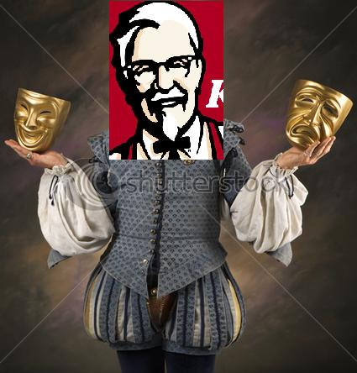
Early-Modern English Ca. 1500-1650
The dialect of the English Renaissance (the word “Renaissance” is French for rebirth).
THIS is the English spoken by Shakespeare.
“Speak the speech, I pray you, as I pronounc'd it to you, trippingly on the tongue; but if you mouth it, as many of our players do, I had as lief the town-crier spoke my lines.” Hamlet, Prince of Denmark. (3.2.1-4)
Linguists tell us that the Early-Modern accent sounded Kentuckian – think Col. Sanders.

Slide 7
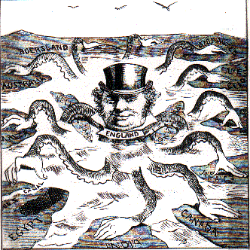
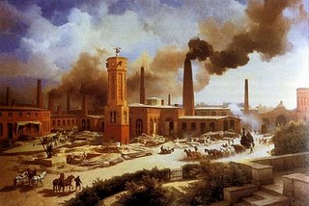
Modern English Ca. 1650 - Present
Modern English is essentially an expanded version of Early-Modern English, that is, the vocabulary of Modern English is substantially larger due to Industrial Revolution and British Colonialism.
Image Source: http://sanmartcult.blogspot.com/2008/11/industrial-revolution-victorian-age.html; http://hemi.nyu.edu/cuaderno/politicalperformance2004/colonialism/colonialismdefinition.html

