Slide 1
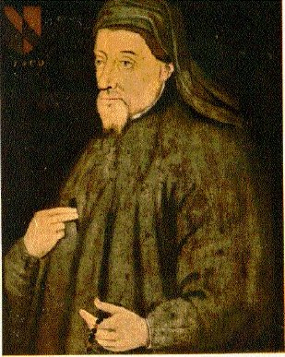
Geoffrey Chaucer & The Canterbury Tales
Famously captures and satirizes life in the late Middle Ages
Author of the poem
The Canterbury Tales

Slide 2
Life and Times
Lives during 14th Century - an age of transition
Son of a wine merchant, born 1340
Educated; served in royal households in admin positions
Able to travel for the crown to France & Italy
Variety of jobs - witnessed the economic, political and social changes in England

Slide 3
Chaucer’s Work
Chaucer’s work experience and travels afforded him with the ability to see people from all levels of society
This exposure allows him to write characters who represent the lower, middle, and upper classes
This in itself is unique. No longer does literature only present the lives of kings and warriors.

Slide 4
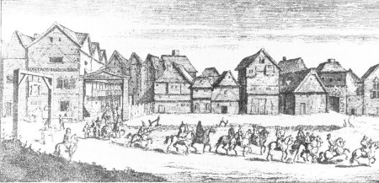
Middle English
The Canterbury Tales was written in Middle English, the primary language spoken by the population
In part due to CT’s popularity, Middle English becomes primary language for the royal court and upper class as well
Chaucer is called “The Father of English Literature”

Slide 5
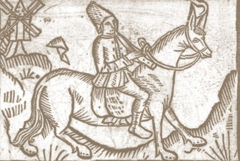
Chaucer’s Tales
Tells the larger tale of the journey of pilgrims to Canterbury Cathedral
Involves storytelling by individuals, who range from a nun, a knight, a cook, a monk, and a merchant

Slide 6
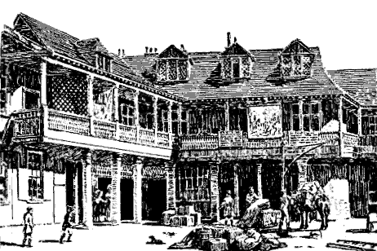
The Premise
Chaucer uses a pilgrimage (religious journey) as a way for 29 characters to share their stories
Leaving from the Tabard Inn (below), the pilgrims are instructed to tell 2 tales on the way to Canterbury Cathedral and 2 on the return journey
Best tale will be rewarded by the inn owner and host of the journey

Slide 7
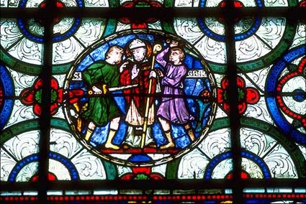
The Premise
Pilgrimages were popular in the period
Show your devotion
Healing properties
Archbishop Thomas a Becket murdered inside Canterbury Cathedral in 1170 when he disagreed with King Henry II over church rights and privileges
The Church canonized him within 3 years of the murder
Most popular pilgrimage site in England in the 13oo’s
Stained glass depicting two knights of King Henry II stabbing Archbishop Thomas a Becket

Slide 8
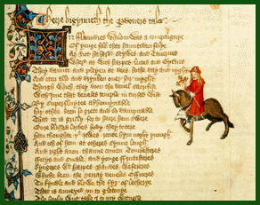
Structure of The Canterbury Tales
3 Parts
General Prologue
Characters’ Prologues
Characters’ Tales

Slide 9
General Prologue
Chaucer’s poem begins with an introduction of all the pilgrims, the host, and Chaucer (who adds himself as a fictional narrator)
Each person is particularly identified by profession and appearance; there is also implied moral judgment.
The GP also sets up the journey and frames the characters’ individual stories

Slide 10
Literary Characteristics of The Canterbury Tales
FRAME STORY:
A literary device in which a smaller story is told within the context of the tale
Example: Chaucer is telling the story of the pilgrims; within that, smaller tales are told

Slide 11
Literary Characteristics of The Canterbury Tales
HEROIC COUPLETS:
2 paired lines of poetry, written in iambic pentameter (meter). The pair (or couplet) must RHYME.
Introduced by Chaucer!
Example:
“You’re off to Canterbury - well, God speed!/
Blessed St. Thomas answer to your need!”

Slide 12
Literary Characteristics of The Canterbury Tales
SATIRE
When an author ridicules and exposes the faults of his or her subject
Used in order to provoke change
The Canterbury Tales is a very important satire, pointing out the need for change in Medieval beliefs and practices
Two tools Chaucer uses to create satire are 1. Verbal irony and 2. physiognomy

Slide 13
Literary Characteristics of The Canterbury Tales
VERBAL IRONY
Is when there is a meaningful contrast between what is said and what is actually meant
Example: Saying, “The best monk,” when really the monk does not really adhere to the ideals of monastic life

Slide 14
Literary Characteristics of The Canterbury Tales
PHYSIOGNOMY:
The use of physical appearance to suggest attributes of a person’s character or personality
Example: Think of evil stepmother figures in Disney movies. Their harsh, angular appearances always hint at their malevolent motives

Slide 15
Characters’ Prologues and Tales
Chaucer meant for each character to share 4 tales in total, but died before he could achieve this
Before each tale, Chaucer includes a prologue or introduction of the person who will tell the tale
Each has a short introduction in the General Prologue, but here he or she is more fully developed
Narrator’s observations
Character’s words, actions, and interactions
Follows with shared tale told to the whole group of travelers.

Slide 16
Types of Tales
ALLEGORY
A story with the purpose of teaching a moral lesson
Characters and events represent abstract qualities or ideas. The writer intends a secondary meaning.
Characters are often personifications of abstractions like greed, envy, etc.
Example: The Pardoner’s Tale

Slide 17
Types of Tales
ROMANCE:
A story focusing on the episodic adventures of knights and the challenges they face
Example: The Wife of Bath’s Tale

Slide 18
from @ChaucerDothTweet
Do a litel daunse. Make a litel love. Gette thee doune thys nighte.
Producte Idea: Greene knighte bobbelheade. The heade kan be removid.
What do alliteratif poetes have for lunche? Caesura salad

Slide 19
Yf any folke have payinge writinge gigges for a bureaucrat-poete, please DM.
Oh thou, thou didst shake me thurgh al the longe nighte.
In reaction to the Jay-Z album Magna Carta Holy Grail:
My reaccioun to Magna Carta ys that yt hath sum solid legal principles that kan be expanded upon yn the future.

